Slide 1
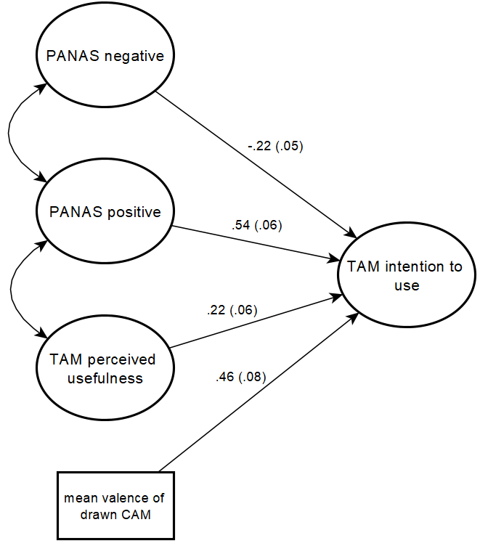
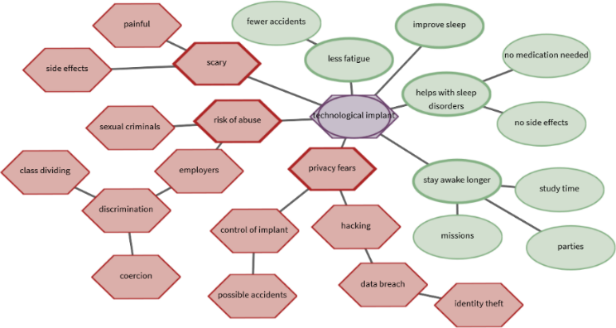
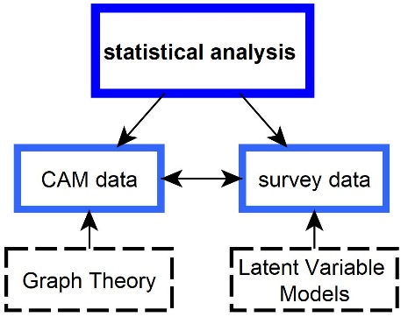

Cognitive-Affective Maps
Cognitive-Affective Maps (CAMs) represent a belief system as a network, using shapes and colors to represent concepts and their associated emotions with lines indicating relations between concepts.
Figure 1. CAM drawn by a participant concerning the acceptance of a fictional nano-implant.
Overall dissertation aim: How can CAMs be used and established as a new mode of quantitative data collection?
Figure 2. Heterogenous data sources will be integrated in the future.
Only recently have CAMs been increasingly researched quantitatively (e.g. Reuter et al., 2021), and currently I am working on an R package to quantitatively analyze these kinds of networks (e.g. aggregating CAMs, computing complex network indicators, splitting CAMs into components) and we have developed a new software to collect CAM data (deployed on GitHub for testing purposes: https://camgalaxy.github.io/).
Pilot study: Predicting technology acceptance using CAMs
Use of a technology can be predicted according to the technology acceptance model (Venkatesh & Bala, 2008). Problem: Questionnaires only assess previously suspected influencing variables. CAMs can be applied to identify further influential factors on technology acceptance (e.g., Livanec et al., 2020).
Can CAM data provide additional information to questionnaires and thus have an additional predictive value?
Participants (N=90) responded to questionnaire scales and drew a CAM regarding a scenario text about a fictional nano-implant to regulate the sleep-wake cycle of humans.
Preliminary data analysis
Structural equation models enable analysis of the acceptance process of a fictional technology. To account for the non-normal distribution of the questionnaire items and the small sample, the DWLS estimator was used and the $X^{2}$ statistic was adjusted. Preliminary result: Highly significant influence of the mean valence of the drawn CAM on the intention to use the nano-implant.
Figure 3. Predicting factors on the intention to use the nano-implant.
Future Research Plans
Replicate the pilot study with sample size determined by a Monte Carlo study.
Systematically analyze CAM and questionnaire data for at least three studies (one dataset already collected) using different outcome variables and including additional structural network indicators.
Identify clusters of similar CAMs using similarity algorithms and compare these cluster results with cluster results of questionnaire data.
Livanec S., Stumpf, M., Reuter L., Fenn J. & Kiesel A. (2021). Who’s gonna use this? Psychological acceptance prediction of emerging technologies and transdisciplinary considerations in the Anthropocene. Manuscript submitted for publication.
Reuter, L., Fenn, J., Bilo, T. A., Schulz, M., Weyland, A. L., Kiesel, A., & Thomaschke, R. (2021). Leisure walks modulate the cognitive and affective representation of the corona pandemic: Employing Cognitive‐Affective Maps within a randomized experimental design. Applied Psychology: Health and Well‐Being.
Venkatesh, V., & Bala, H. (2008). Technology acceptance model 3 and a research agenda on interventions. Decision Sciences, 39(2), 273-315.
Exploring cognitive affective maps as a new mode of data collection
Julius Fenn, University of Freiburg

